Slide 1
CD Catalog
Tarun Kumar sarkar

Slide 2

Problem Description
Input
Process
Record

Slide 3
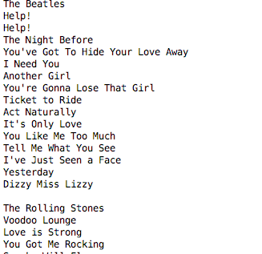
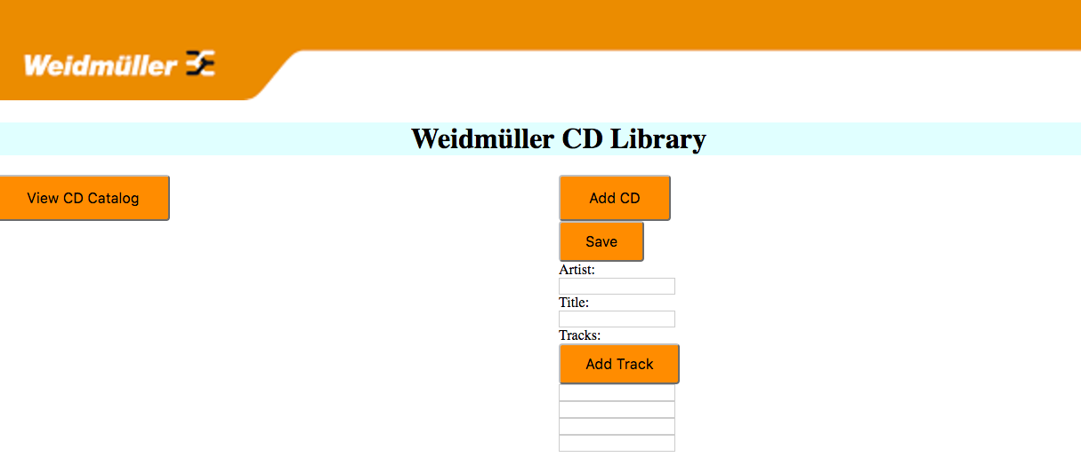
Input
Plain text file
Manual input

Slide 4
Process
Plain text file input
Read input data
Parse data
Manual input
Capture data
Map data

Slide 5
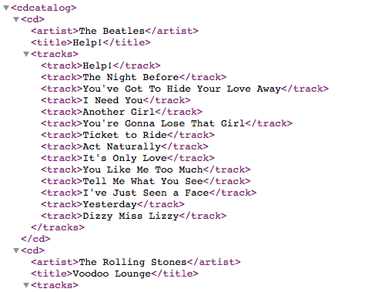
Record
Structure definition
Store data

Slide 6
Demonstration

Slide 7
Thank you!!

